Slide 1
PROCUREMENT MANAGEMENT SYSTEM
GROUP NO - 15
DESIGNED AND DEVELOPED BY-
AJIT PATIL 2737058
ANKIT LALL 2799095
MAHESH NEELESH POOJARY 2766647
SHREYA DESHPANDE 1002875

Slide 2
Problem Statement
Traditional procurement methods lack a centralized approach for obtaining items from suitable vendors, resulting in poor visibility over cash flow and vendor selection. A procurement management system, however, standardizes procurement processes and incorporates best practices, making it a crucial aspect of overall business strategy.

Slide 3
Objectives
1. Drastically Speed Up Turnaround Time
2. 100% Visibility of Purchasing Expenses & Accounts Payable
3. Reduce Risk of Procurement Fraud
4. Streamline Auditing

Slide 4

Proposed Solution
The Procure-to-Pay (P2P) process is a method of streamlining the purchasing and accounts payable procedures, with the aim of increasing efficiency and freeing up capital. The traditional accounts payable process often involves multiple manual steps and approvals, leading to delays in vendor payments. The P2P process uses streamline approach to integrate purchasing and accounts payable processes and remove any unnecessary steps.

Slide 5
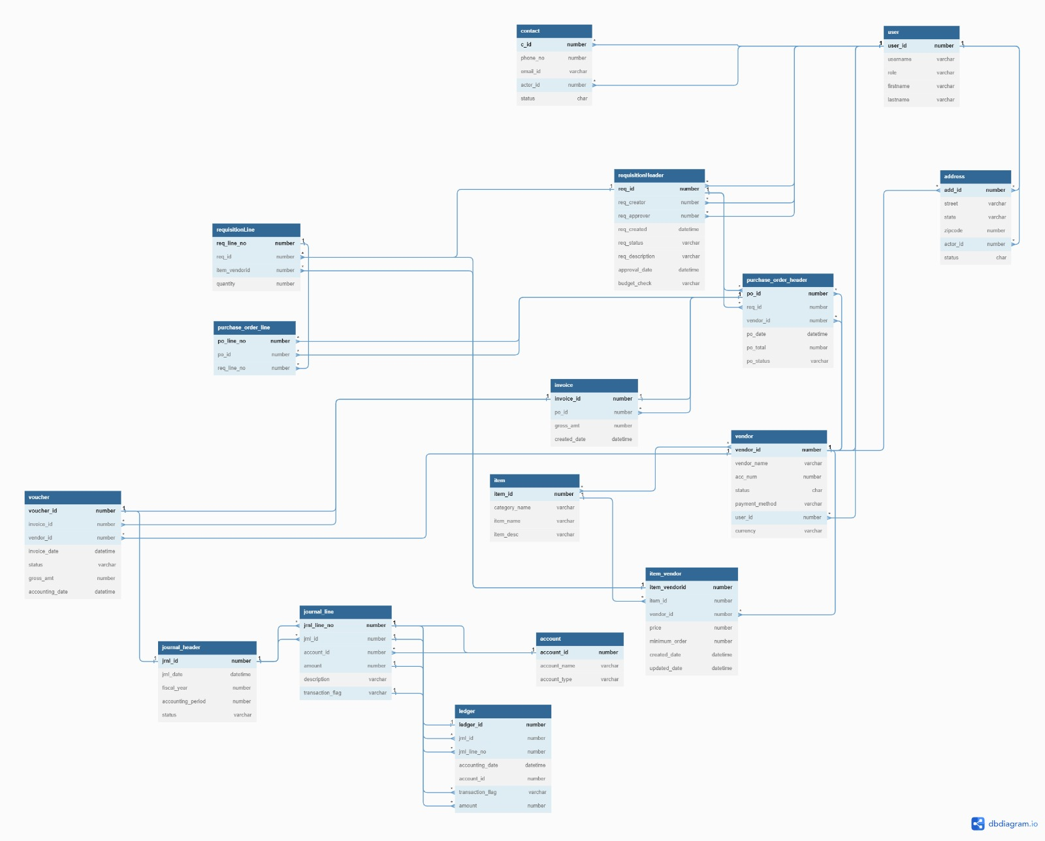
ER Diagram

Slide 6
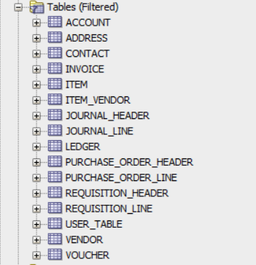
Tables

Slide 7

Triggers

Slide 8
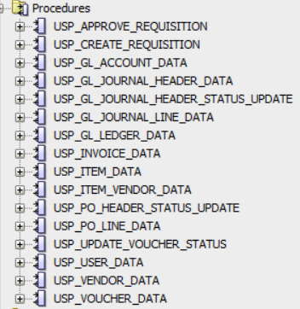
Procedures

Slide 9
Reports
Most Purchased items view
Favourite Vendor view
Purchase Report view
Vendor Details view
Financial Report view

Slide 10
Contribution
Ajit Patil: Tables creation, Views, Stored procedures, QA testing, GIT management, Data Insertion, Security
Ankit Lall: Tables creation , Views, Functions, GIT management, Data Insertion, QA testing, Stored procedures
Mahesh Neelesh Poojary : Tables creation,Clean up scripts, Security, Stored procedures, Triggers, GIT management, QA testing
Shreya Deshpande : Tables creation , Security, QA testing, GIT management, Data Insertion, Stored procedures, Views

Slide 11
Thank You

